Slide 1
Wiki Women Workshop – 2014
K.Sibi
Executive Committe Member
Free Software Foundation Tamil Nadu
sibi@fsftn.org

Slide 2
Me and Wiki ;)
Wikipedia user name : Commons_sibi
Member Since : 25 March 2013
Wiki contributions : 1758 edits found in 22 projects. *
In specific :
*As on 6th March , 2014
commons.wikimedia.org | 280 edits With major contribution to “Diagrams in Tamil”
en.wikipedia.org | 617 edits
ta.wikipedia.org | 675 edits
ta.wikiquote.org | 19 edits

Slide 3
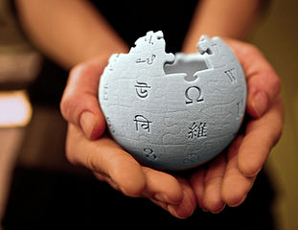
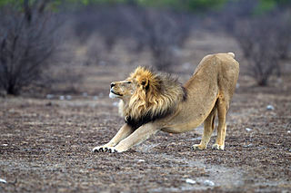
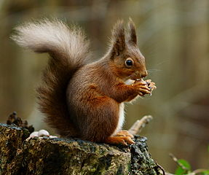
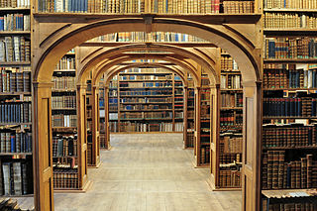
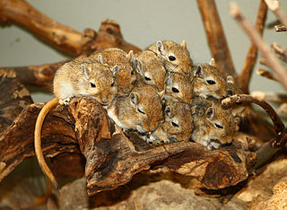
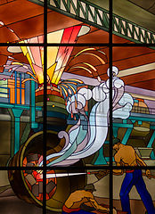
Some resons why people edit wikipedia ?
Ideology – Knowledge should be free
Enhancement – Demonstrating knowledge to others
Fun – Enjoying the activity
Understanding – Expanding knowledge through activities
Values – Expressing values to do with altruism
Social – Engaging with friends,
Content Courtesy : https://en.wikipedia.org/wiki/Wikipedia_community#Motivation
Image Courtesy : Wiki Commons

Slide 4
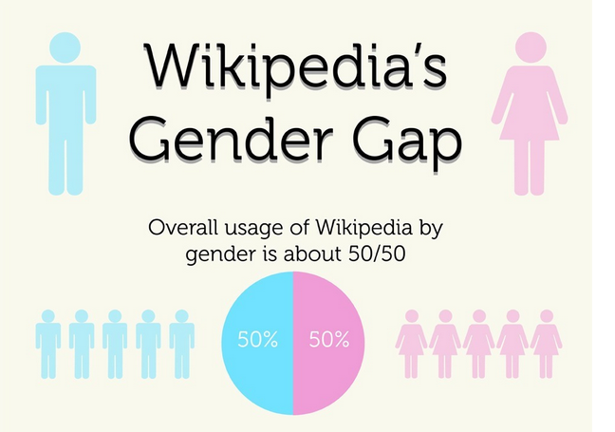
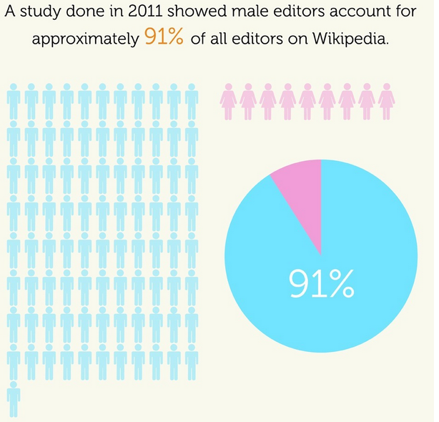
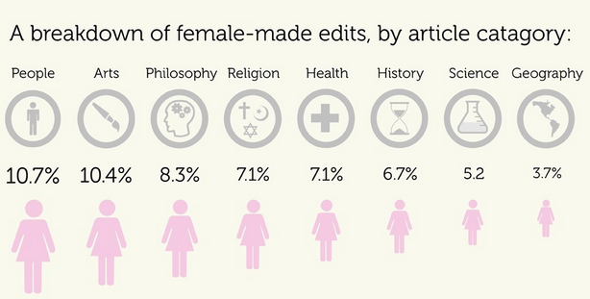
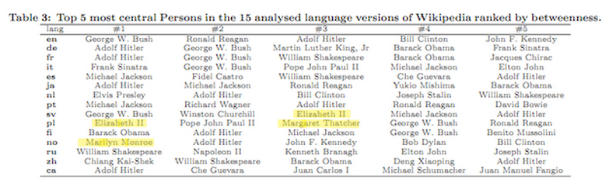

Wikipedia's Gender Gap
Infographics Courtesy : http://mashable.com/2012/08/08/wikipedia-gender-graphic/

Slide 5
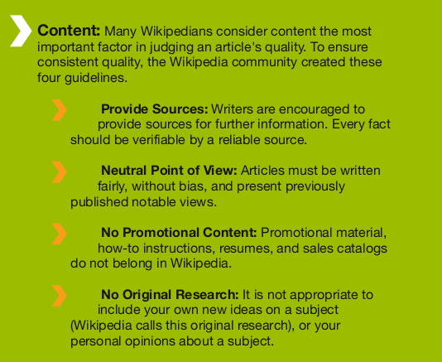
Few points before editing –
4 pillars of Wikipedia

Slide 6
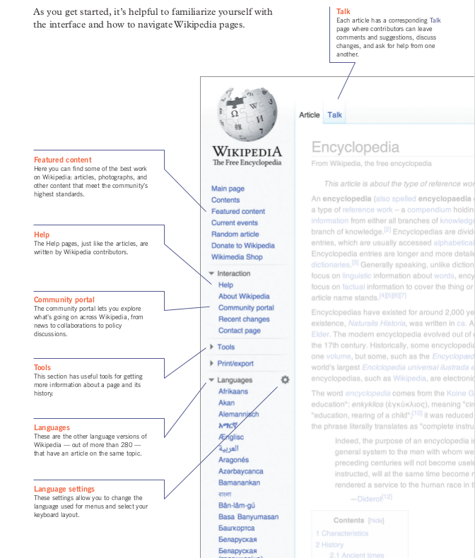
Few points before editing –
Structure of interface

Slide 7
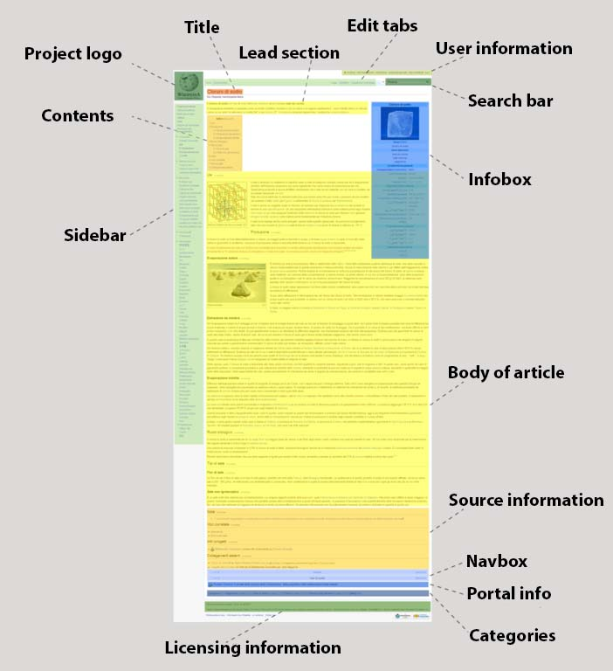
Few points before editing –
Typical Structure of a Wikipedia Article
Image Courtesy : https://commons.wikimedia.org/wiki/File:Anatomy_of_a_Wikipedia_article.jpg

Slide 8
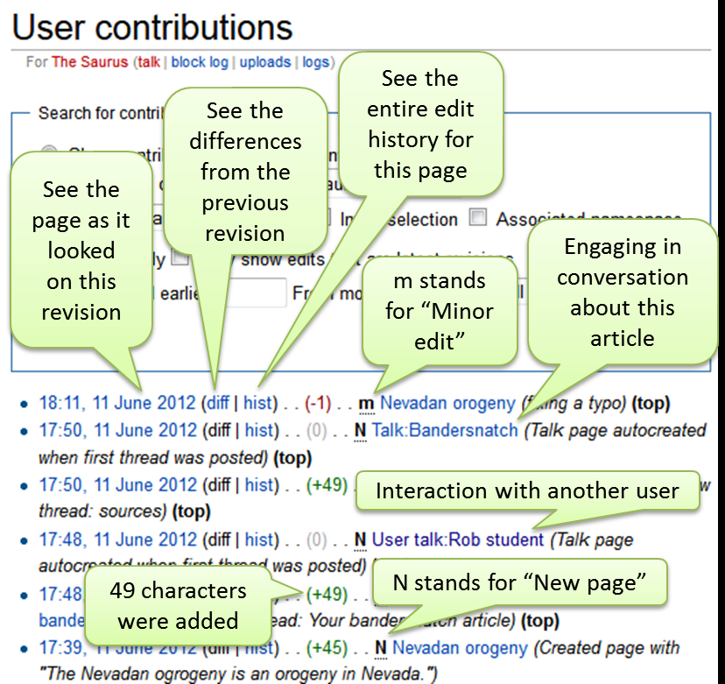
Few points before editing –
A look at the contribution page
Image Courtesy :https://commons.wikimedia.org/wiki/File:User_contributions.png

Slide 9
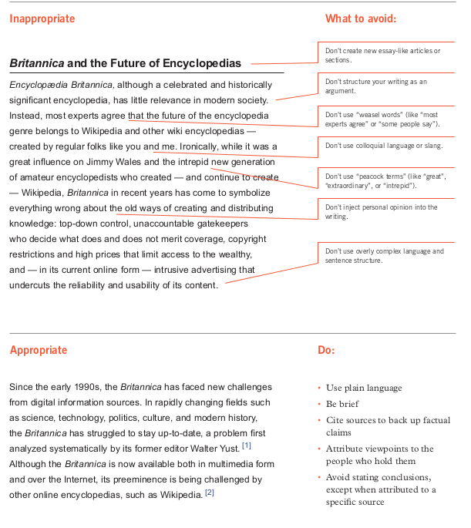
Few points before editing –
What to do , more importatly what not to

Slide 10
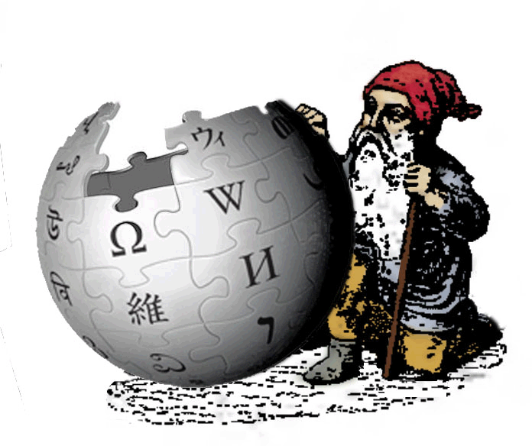

Where to start ?
WikiGnome is a wiki user who makes useful incremental edits like spelling correction
Illustrator: Uploads images, photographs, maps, and visual aids relevant to the article.
Author: Adds information to articles from books, websites, newspapers, and other credible sources. An author also initiates the creation of new articles.
Reference checker: Evaluates references provided at the bottom of the article to check if they are verifiable sources. When reference checkers find a sentence with [citation needed] next to it, they add a reference if to a verifiable resource that validates that view.
Mediator: Moderates discussion on controversial topics, helps resolve disputes, and provides guidance on contributor behavior.
Copy editing (also copy-editing, copyediting) is the work that an editor does to improve the formatting, style, and accuracy of text.
Formatter: Structures or "wikifies" articles, using wiki markup, so they are easier to read. When Formatters come across a page that says, "This page needs clean up", they use their skills to improve the overall structure of the article
Maintainer: Monitors articles for biased edits and corrects them.

Slide 11
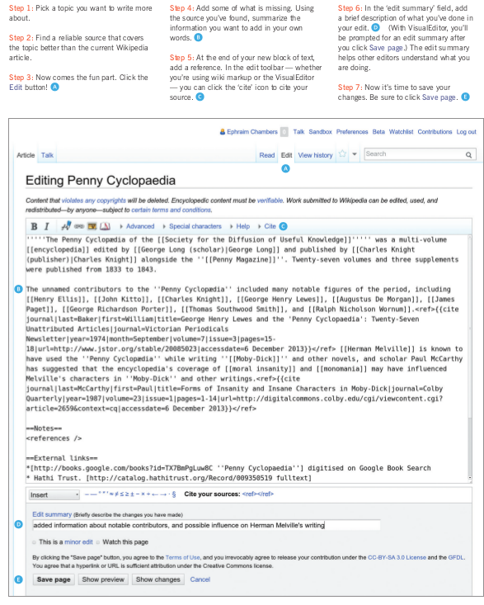
How does a page look like

Slide 12
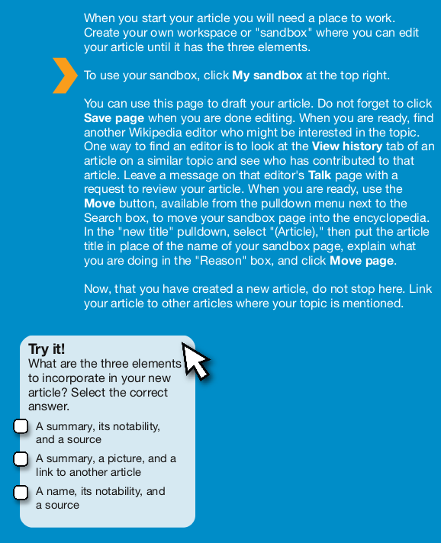
Creating a Wikipedia article –
Use Sandbox :)

Slide 13
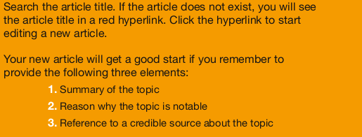
Creating a Wikipedia article –
Things to be taken care of

Slide 14











Other Projects

Slide 15
Thank you
Happy Editing
Happy Contributing

